Slide 1
LOW POWER COMPUTING
Topics
General Remarks Power and Energy Basic Techniques ▪ Parallelism ▪ VLIW (parallelism and reduced overhead) ▪ Dynamic Voltage Scaling ▪ Dynamic Power Management

Slide 2
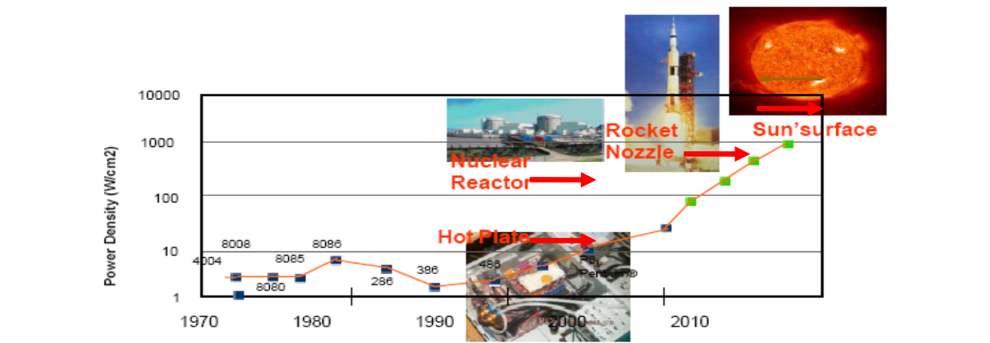
Power and Energy Consumption
Need for efficiency (power and energy): „Power is considered as the most important constraint in embedded systems.” [in: L. Eggermont (ed): Embedded Systems Roadmap 2002, STW] “Power demands are increasing rapidly, yet battery capacity cannot keep up.” [in Diztel et al.: Power-Aware Architecting for data-dominated applications, 2007, Springer]

Slide 3
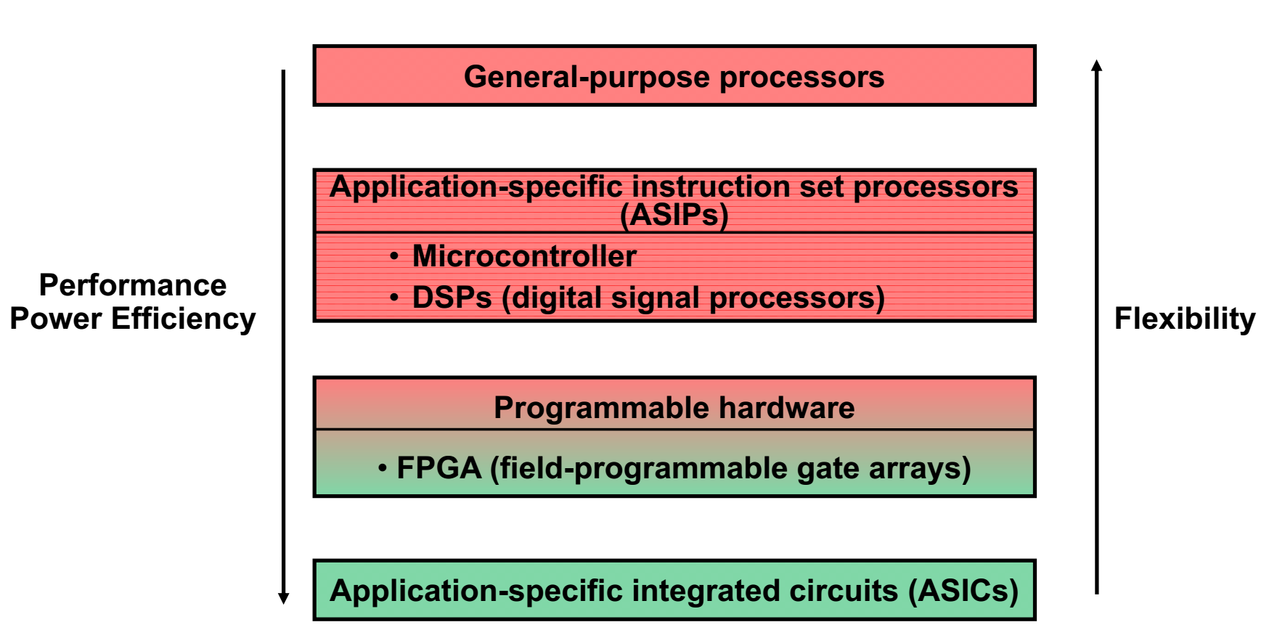
IMPLEMENTATION ALTERNATIVES

Slide 4
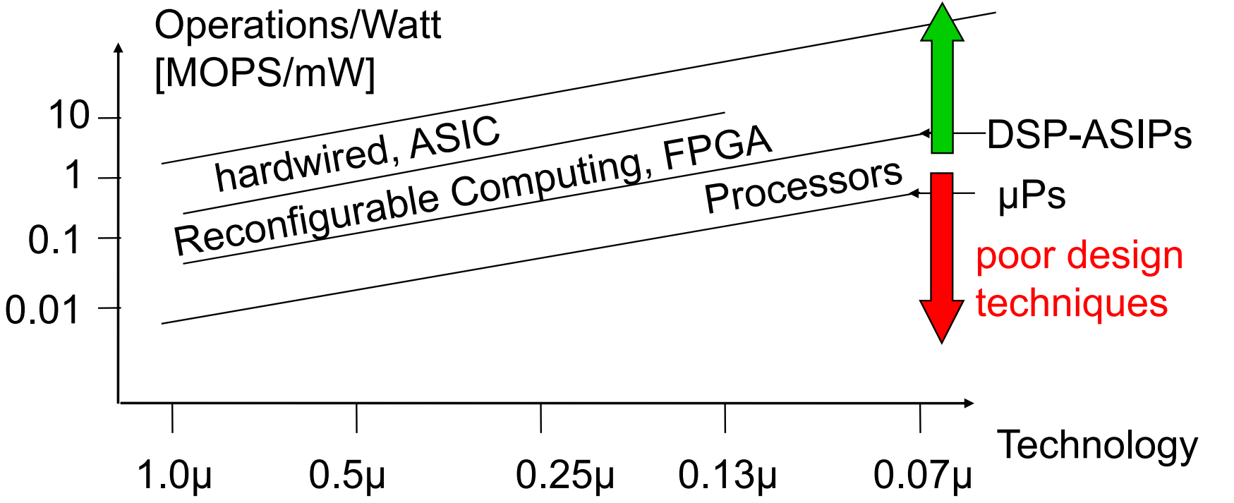
POWER EFFICIENCY CONFLICT
Necessary to optimize HW and SW Use heterogeneous architectures Apply specialization techniques.

Slide 5
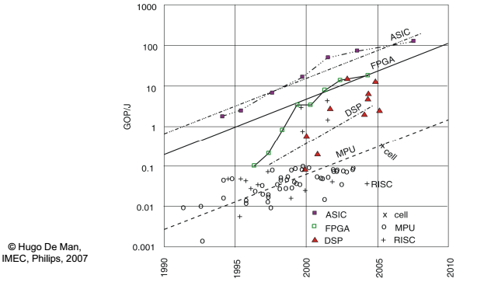
Energy Efficiency

Slide 6
Topics General Remarks Power and Energy Basic Techniques ▪ Parallelism ▪ VLIW (parallelism and reduced overhead) ▪ Dynamic Voltage Scaling ▪ Dynamic Power Management

Slide 7
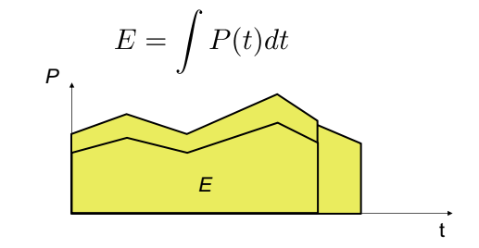
Power and Energy are Related
In many cases, faster execution also means less energy, but the opposite may be true if power has to be increased to allow faster execution.

Slide 8
Low Power vs. Low Energy
Minimizing the power consumption is important for ▪ the design of the power supply ▪ the design of voltage regulators ▪ the dimensioning of interconnect ▪ cooling (short term cooling) • high cost (estimated to be rising at $1 to $3 per Watt for heat dissipation [Skadron et al. ISCA 2003]) • limited space Minimizing the energy consumption is important due to ▪ restricted availability of energy (mobile systems) ▪ limited battery capacities (only slowly improving) ▪ very high costs of energy (solar panels, in space) ▪ long lifetimes, low temperatures

Slide 9
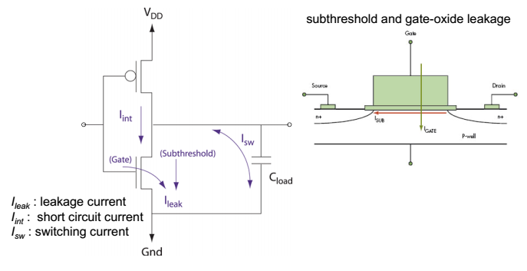
Power Consumption of a CMOS Gate

Slide 10
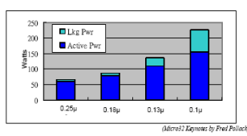
Power Consumption of CMOS Processors
Main sources: ▪ Dynamic power consumption • charging and discharging capacitors
▪ Short circuit power consumption • short circuit path between supply rails during switching
▪ Leakage • leaking diodes and translators • becomes one of the major factors due to shrinking feature sizes in semiconductor technology

Slide 11
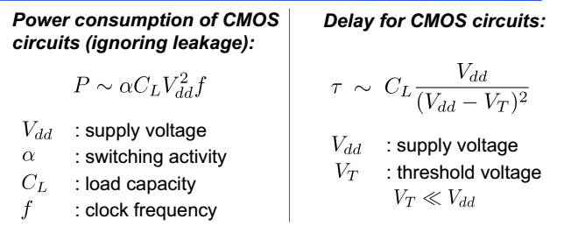
Dynamic Voltage Scaling (DVS)
Decreasing Vdd reduces P quadratically (f constant). The gate delay increases reciprocally with decreasing Vdd . Maximal frequency fmax decreases linearly with decreasing Vdd

Slide 12
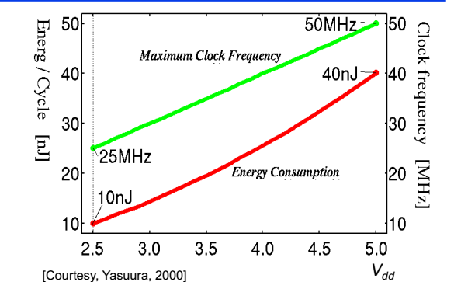
Example: Voltage Scaling

Slide 13
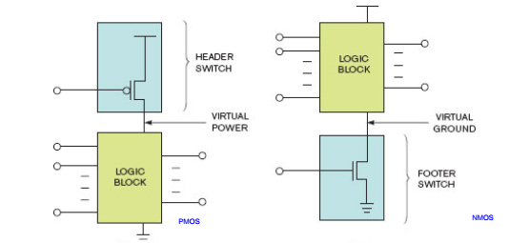
Power Supply Gating Power gating is one of the most effective ways of minimizing static power consumption (leakage) ▪ Cut-off power supply to inactive units/components ▪ Reduces leakage

Slide 14
Topics General Remarks Power and Energy Basic Techniques ▪ Parallelism ▪ VLIW (parallelism and reduced overhead) ▪ Dynamic Voltage Scaling ▪ Dynamic Power Management

Slide 15
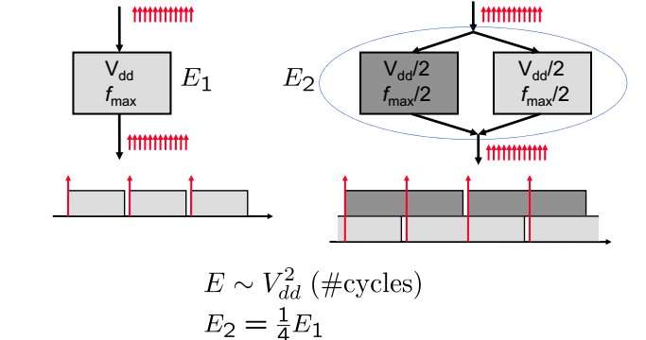
Use of Parallelism

Slide 16
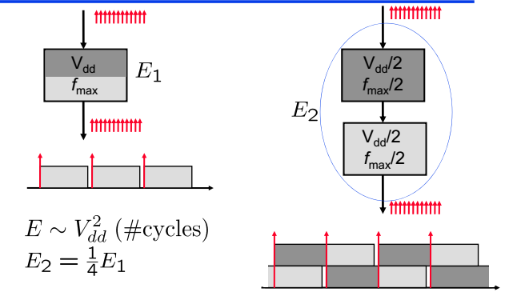
Use of Pipelining

Slide 17
Topics General Remarks Power and Energy Basic Techniques ▪ Parallelism ▪ VLIW (parallelism and reduced overhead) ▪ Dynamic Voltage Scaling ▪ Dynamic Power Management

Slide 18
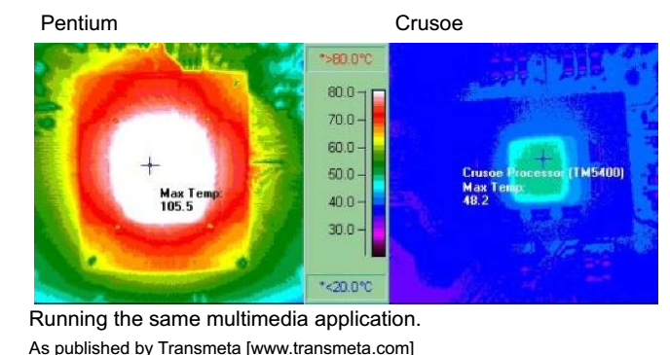
New ideas help …

